Slide 1

Itron Riva Edge Platform based Business solution proposition for Ignite Contest
September 2016

Slide 2
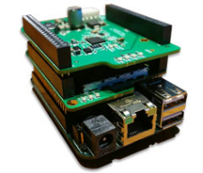
Contents
About the Business Solution
Project Objective and Description
Project Target Market
Problem Being Solved
Solution Approach and Design
Technical Architecture
OpenRiva Implementation
User Application
Application Solution Snapshots
Solution Extensibility
Assumptions
Deliverable References

Slide 3
About the Business Solution
1

Slide 4
Business Problem Statement and Objective
Problem Statement:
Outage management during blue sky and storm situations is a challenging business operations management and most of the Utilities’ response is reactive;
Utilities’ performance is determined by its efficiency in restoring the outage and is measured by various parameters like SAIDI, SAIFI, etc.; these are monitored by regulatory commissions, thereby high pressure on business operations on effective outage management;
Utilities’ customer satisfaction usually takes a hit with reactive communication of outage & restoration.
Objective:
Predict and proactively communicate outages and manage estimated restoration times to achieve enhanced customer satisfaction;
Utilities continue to invest and research in emerging technologies and solutions that can improve its outage management operations; leverage the AMI data to message near real-time on status of outages at service points & transformers;
Utilize the fast growing analytics and IoT space is demonstrating the ability to predict accurately potential outages and efficiently dispatch crew to fault locations;
Itron’s OpenRiva platform along with Itron Smart Meters can be a foundational technology framework that can enable utilities to receive near real-time communication on sustained outages and also effectively support proactive communication on the outage situation and restoration status.
Notes:
Today, with the increasing requirements on utilities to track and report outages accurately, OMS is a critical analysis tool. Functions that an OMS may support include accurate time stamping of outages and restoration by customer, crew tracking, predicting of outage causes, generating information of interest to customers, and creating call-back lists and reports for management and regulatory reasons.
System Average Interruption Frequency Index (SAIFI)
System Average Interruption Duration Index (SAIDI)

Slide 5
Benefits of the Solutions
Effective Outage Management:
Enables near real-time outage notification to operations thereby quickly predicting the fault locations by the operations team;
Enables efficiency in crew management for nested outages resolution;
Enables integration of outage events with OMS systems and improves fault analysis;
Integrating OMS with real time meter status/events helps operations situational intelligence to locate and validate cascading outages;
Improved notification of power restoration lowers operations and maintenance cost;
Improved and reliable data to support regulatory reporting needs.
Proactive Communication:
Enables immediate and proactive communication (SMS/email) to affected customers on the outage incidents and restoration status;
Enables 2-way communication between the consumers and utility;
Provides a visual look and feel of the outage and the restorations in an area for both the consumers and field crew.

Slide 6
Solution Approach and Design
2
Architecture, Use Case, Design and Customization

Slide 7
Solution Overview
Itron’s OpenRiva Platform:
Simulated outage data stored in edge board for this contest; Envisioned to get real-time data when connected to devices like smart meters;
Capitalized the SDK to parse and push the power outages/restorations from Smart Meters to Cloud Infrastructure;
Customize OpenRiva platform to parse for sustained power outages and roll-up the outages.
Amazon Cloud Services:
Mule ESB to support for heterogeneous data sources, with the edge board being only the single source for current implementation;
Streaming service to support for live streaming of outage data within the application.
Feature/Map Service to perform analytics and display the affected Service Points & Transformers.
Trigger email/SMS communication to consumers/field crew of power outage/restoration.
Web/Mobile Application:
Live update of the power outage/restoration on to the map;
Visual look and feel of the outages in the region;
Alerts to the field crew/consumers within the application.

Slide 8
Solution Architecture

Slide 9
Outage/Restoration - Operational Use Case
Analytics at Edge

Slide 10
Outage/Restoration – Data Flow

Slide 11

Riva Edge Board Implementation Stack
Itron Edge Board (TI :: AM335x)
Cyient Application
(Using the Itron SDK)
RF Mesh Network IPV6
Data Acquisition
Analytics
3rd Party
Metering
Cloud Sync
Configuration Manager : Wifi, Sensor, Celular, Metering..
SKY65362
RF
Itron
SQLLite
UUID / Version
Data Record
Event Log
SPI
Img Processor
Plugin Loader
IPV4/IPV6
XML
TCP/IP
Wifi
FileSystem
Crypto
TMS320F28377D
Itron Platform Stack
Linux Libaries
DSP
glibC
SDIO
Power Mng
BT
GPIO
SPI
I2C
ADC
PLC Core 2
RF Core 1
Linux Drivers
Ethernet
USB
UART
Other
SPI

Slide 12
Riva Edge Board Cyient Application
Edge Analytics
Itron EDGE Board with Cyient Application with ACT Technology
SQLite for Internal Storage and Manage Data
Cloud Connect WiFi/Ethernet/RF Mesh Network
Firmware Upgrade Over the Air
3rd Party Sensor Integration (Smart Plug)
XML Parser for Configuration Management from Cloud
Note: The proposed features that can be implemented using SDK feature available in Itron Edge Board are colored Orange.

Slide 13
Riva Edge Board Development – Cyient Recommendations
Feature / Document Recommended | Developer View Point | Comments
Example Edge Application programs in the SDK | Which uses the Itron platform library / Features available | This will help user for rapid prototype the use case
Firmware Upgrade over the Air | Implementation of 3rd path firmware upgrade feature from Riva cloud
UI or text (ex: xml ) based Configuration | Implementation of pushing the device configuration from cloud for any change in the device configuration

Slide 14
Riva Edge Board Documentation – Cyient Recommendations
Feature/Document Recommended | Developer View Point | Comments
Push Edge Application to Edge Board | Documentation to push the application directly to the board via network rather than USB stick | Will reduce development time for any Itron board user
Software Architecture | Representing all the modules available in platform for developer usage | Faster understanding of platform and development time
Example Edge Application Programs in the SDK | Which uses the Itron platform library/features available | This will help user for rapid prototype the use case
Mesh Network Documentation | To detail how the individual device gets connected to internet via RF based mesh network
Configuration | Sensor configuration details
Proximity AirSync Agent | Briefing on the usefulness of this Agent
ACT Technology | Details of the usage of ACT and the architecture of how communication switch takes place

Slide 15
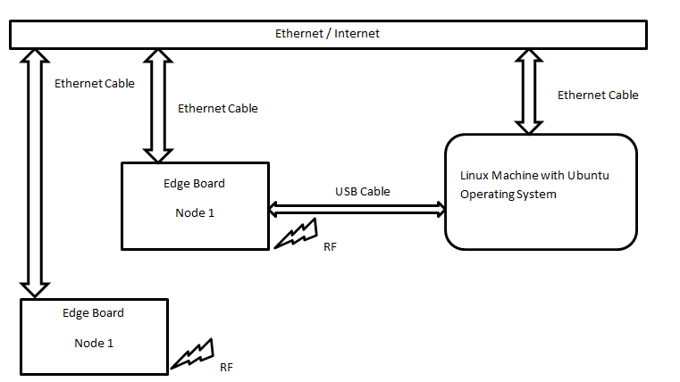
Design on OpenRiva Platform
Owing to this prototype implementation, the outage data is simulated and stored in a text file in the Ubuntu machine, which can be updated manually.
Text file is read over network and made available in the Edge board. The data under this file will be fetched and processed.
This data will be pushed to cloud via the API designed by cloud team. This transmission happens via internet (Not RF). Internet connected is through the Ethernet cable connected to Edge board.

Slide 16
Dashboard and Consumer App Design

Slide 17
Application Solution Snapshots
3

Slide 18
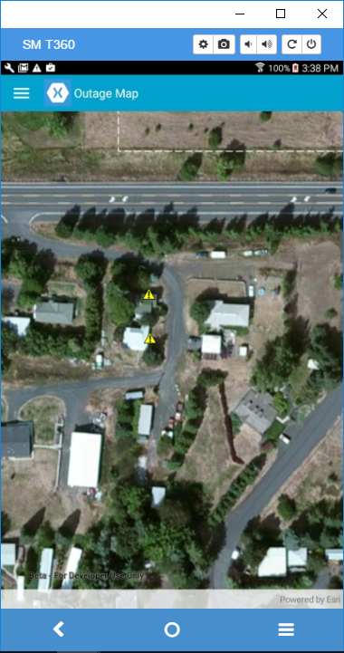
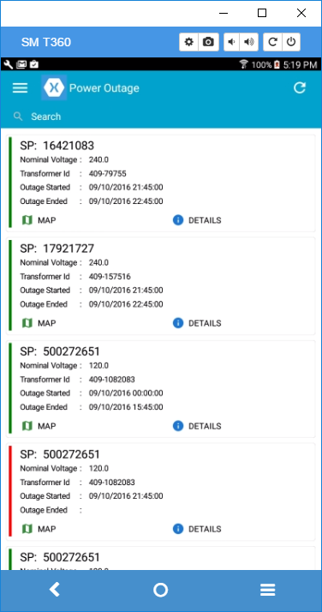
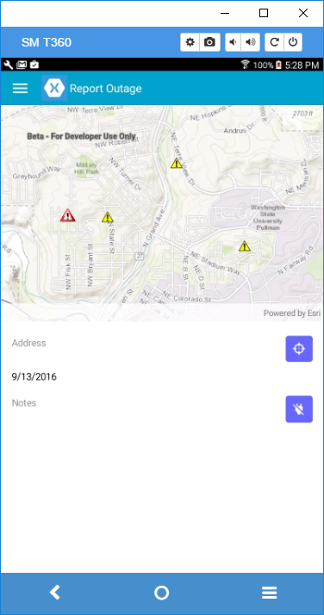
Mobile Application - Snapshots
Outage Map
Outage Attributes
Reporting Outage

Slide 19
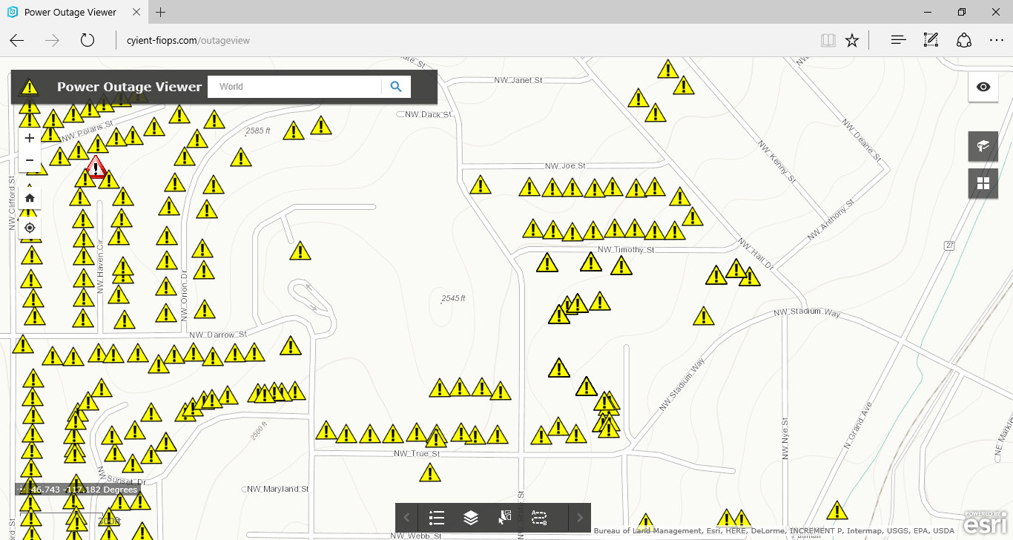
Web Application

Slide 20
Solution Extensibility
4

Slide 21
Solution Extensibility/Findings – OpenRiva Edge
Itron Edge Platform Feature | Cyient’s Understanding | Comments
Mesh Network Topology | Can be used to create mesh network and connect Internet of things with highly reliable and low bandwidth suitable for IOT use cases | As per Riva loud support team, urrently Itron Edge board is not supported by Riva Cloud
High processing | Itron uses Am335x (TI ARM A8 Processing) | High processing can be used to add analytics in the Edge Board
Storage | Support SQLite | Used SQL lite in Cyient App to store the power outage data
WiFi/Ethernet/Cellular Configuration | Easy configuration | Cyient Edge App uses Ethernet to push the data to cloud
3rd Party Application Development | Supports C, C++ and Python 2.7 | Cyient Edge App uses Python 2.7
Proximity AirSync Agent | Can be used for :: Automatic Mesh Protocol Detection, Support of IPV4 and IPV6, Ethernet based ID (DID), RSSI | As per Riva Cloud support team, currently Itron Edge board is not supported by Riva Cloud

Slide 22
Solution Extensibility – Operations Interface
# | Functional Area | Functional Details
1 | Restoration Time Estimation | Integration with OMS or other systems to determine the restoration time based on the level of outage.
2 | Analytics | Analytics can be performed to represent the outage beyond transformer, outage phase-wise and also can be extended for historical data analytics.
3 | Outage/Restoration Reporting | Enhance the existing functionality to better handle the two-way communication between the consumer and the utility.
4 | Authentication/Authorization | Configure/implement the security in managing the CRUD operations.
5 | Other Views of Data | Apart from the map, other representations like the graphs, charts can be included.
6 | Other Data Analytics | Other information as received from the edge board like voltage, load etc. events data can be utilized to perform wide variety of analytics and represent them geographically.

Slide 23
Assumptions
5

Slide 24
Implementation Assumptions
Our assumptions are as follows:
This application is primarily targeted for real-time outage
Only the registered consumers with email and cell phone numbers will receive the notifications
Implementation is based on a simulated outage feed since we didn’t have access to a SmartMeter to simulate the outages
Technical Environment and Development Framework – C++ & Python on the edge board and C#.Net for the application.

Slide 25
Deliverable References
6

Slide 26
Reference to Final Deliverables
What? | Where? | Notes
Edge development code | https://github.com/rbprayaga/Itron_Ignite_Contest_2017
UI development code | https://github.com/rbprayaga/Itron_Ignite_Contest_2017
Code release notes and other related instructions for deployment | Readme.txt | Includes configuration details and mobile application deployment
Demo video recording | Itron_Ignite_Contest-Cyient_Demo.mp4 | Includes Edge board operation and application navigation

Slide 27
Thank You
A special thank you to Peter Sanburn and Norm McEntire from Itron for timely support answering our questions.

